Slide 1

SVKM’s Institute of Technology, Dhule Department of Information Technology
Project Phase I Presentation
On
“Milk Purity Detection System”
By
14.Nikita Kantilal Deshmukh
01.Kumudini Suresh Bagul
64.Divya Lalchand Chaudhari
57.Rushikesh Ravindra Yeole
Guide
Dr. Bhushan Chaudhari

Slide 2

Content
Group Details
Introduction
Literature Survey
Problem Statement and objective
Scope of project
Proposed system
Hardware and software requirement
Results
Conclusion
Refrences

Slide 3
Group Details
Project Title : Milk Purity Detection System
Project Group Members:
T2054491246033, Nikita Kantilal Deshmukh.
T2054491293012, Kumudini Suresh Bagul.
T2154491246504, Divya Lalchand Chaudhari.
T2054491246049, Rushikesh Ravindra Yeole.

Slide 4
Introduction
Milk plays a vital role in the diets of people all over the world because of its high nutritional value. It is becoming more difficult to verify the validity and quality of the milk that is sold in the market, though, as concerns about adulteration, and contamination.
It is crucial to guarantee milk purity and accurately identify its sort in order to protect both the consumer's health and the dairy industry's reputation.
Therefore there is an urgent need for creative, economical, and user-friendly technologies that enable people to make wise choices regarding the milk they consume.
So we have developed an advanced system that makes use of sensor technologies in conjunction with the Blynk mobile application to close this gap and provide customers with the power to make knowledgeable decisions

Slide 5
Literature Survey
Existing system | Description | limitations
1) A Low-Cost NIR Digital Photometer Based on In Gas As Sensors for the Detection of Milk Adulterations With Water | They proposed a prototype of a digital photometer to quantify water added to milk. This is a microcontroller, portable device, which uses three LEDs with emission in the near infrared (IR) region | It fails when other chemicals are added to the adulteration, it doesn't work
2) Edge-AI Implementation for Milk Adulteration Detection | Edge-AI-based architecture allows the implementation of in-situ milk adulteration detection techniques in dairy processing, hence providing real-time monitoring of milk quality | A Convolutional Neural Network (CNN) model is used so a larger dataset is required thereby additional power consumption and has limited memory for operations.
3) Development of Spectroscopic Sensor System for an IoT Application of Adulteration Identification on Milk Using Machine Learning | they designed and developed a lowcost,portable,multispectral, AI-based, non-destructive spectroscopic sensor system that can be used to detect the milk adulterant in real-time. | The model performance will be degraded, if the distance between sensor and the milk sample is greater than one inch. few adulterants which will be mixed in the milk are not explored.

Slide 6
4) Milk Adulteration Monitoring | A Milk Quality Monitoring System using an ATmega328 microcontroller interfaced with multiple sensors which analyses the quality of milk The system monitors the specific type of proteins A1 and A2 are specific types of proteins found in cow’s milk | The system is limited to measure only the adulteration in A1 and A2 milk samples.
5)Real-Time Milk Monitoring System | uses a combination of gas sensor arrays with a magnetoelastic sensor. The gas sensor monitors the bacteria for fast measurement of spoilage of milk and it uses a wireless system with a magnetoelastic sensor. | Here only the bacteria affecting the milk is taken into consideration and it does not take care of other important parameters like pH value, pigmentation detection, and density
6) Internet of Things Milk Spectrum Profiling for Industry 4.0 Dairy and Milk Manufacturing | determines the fat and protein content in milk using LED’s, a mini-spectrometer, LED, and a microcontroller | This system only concentrates on the fat and protein content and no assessment on the quality of other parameters and the storage of results were done.

Slide 7
Problem Statement and Objective
To monitor adulteration of milk in real time in order to reduce health problems and provide accurate analysis to determine purity and quality of milk and which type of cattle milk by using IOT .
The primary objective of the system is to combat the pervasive issue of milk adulterants like water, starch, and chemicals often added to milk to increase volume or mask quality deficiencies, leading to compromised nutritional value and potential health hazards.

Slide 8
Scope
The framework ensures accessibility and affordability for a broad variety of farmers by providing configurable solutions that may accommodate dairy enterprises of any size.
The framework's contributions to the avoidance of foodborne illnesses and the spread of diseases spread by contaminated milk are critical to the preservation of public health and the enhancement of the dairy industry's overall integrity.

Slide 9
Proposed System
Humidity sensor
ESP-32
(wroom-32)
Sensors
TDS Sensor
(DS18B20)
Cloud Software
Colour Sensor
(TCS3200)
Milk
Sample
Milk History
Ph Sensor
(4502C)
Temperature Sensor
(DS18B20)

Slide 10
Hardware & Software Requirement
Hardware Requirement :
ESP32 : It’s serves as a foundational tool for individuals seeking to explore the realms of electronics, programming, and IoT .
PH Sensor : Detects Ph Value of Provided milk.
TDS Sensor : Detects Total Dissolve Solids in milk.
Temperature Sensor : Detects Temperature of Provided milk.
Color Sensor : It is use to find the milk of cattle using RGB value.
Software Requirement :
Blynk IOT : It is an IoT platform for iOS or Android smartphones that is used to control Arduino, Raspberry Pi and NodeMCU via the Internet.

Slide 11
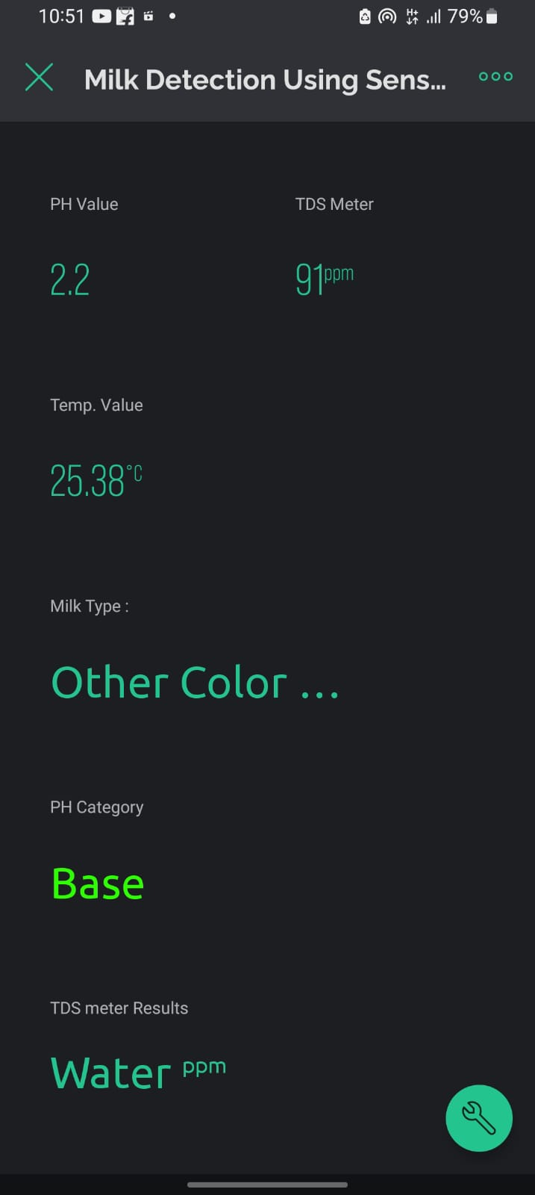
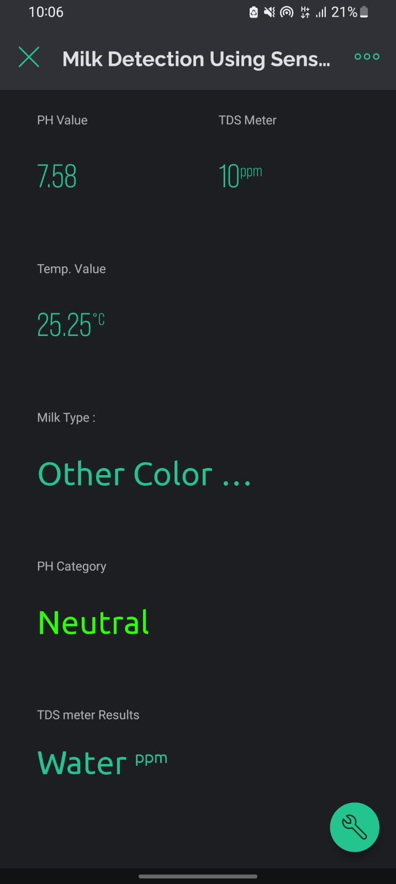
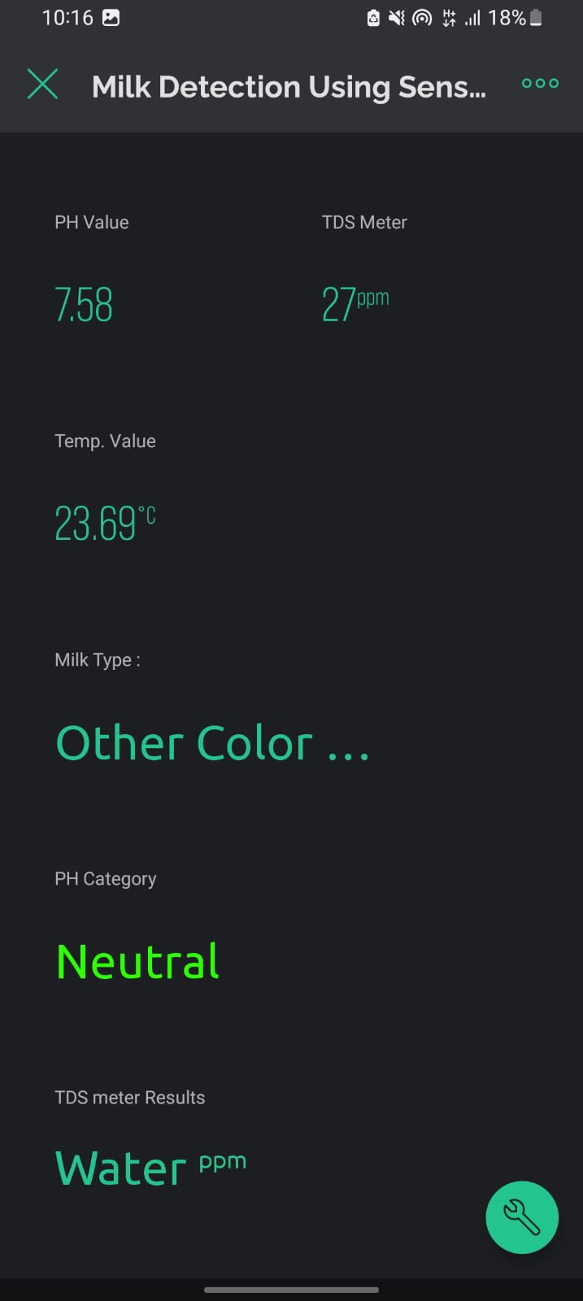
Result
Results of the systems

Slide 12
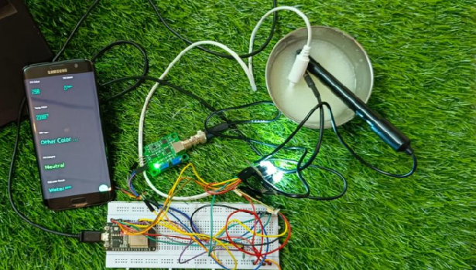
Proposed System of Milk Purity Detection System

Slide 13
Conclusion
The Milk Purity Identification Project was a significant effort to improve quality control processes in the dairy industry. Through an extensive feasibility study, design, development and testing, the project successfully met the need to create a robust system capable of detecting contaminants. The project successfully used cutting edge technologies such as advanced sensors, image processing algorithms and machine learning models to develop an advanced milk purity detection system. Real-time monitoring capabilities have been integrated to immediately detect deviations from quality standards and generate comprehensive reports on each milk sample.

Slide 14
References
[1]Ali Yavari, Dimitrios Georgakopoulos, Himanshu Agrawal, Harindu Korala Prem Prakash Jayaraman, Josip Keratotic Milovic “Internet of Things Milk Spectrum Profiling for Industry 4.0 Dairy and Milk” 2021 IEEE 2nd International Conference on Mobile Networks and Wireless Communications (ICMNWC)
[2]Nayeem Abdullah, Ahnaf Shahriyar Chowdhury, Md.Mehedi Hossain “Real-Time Milk Condition Surveillance System” 2021 Conference on Information Communications Technology and Society.
[3]Kathiravan Pugazhenthi Anandhan Sengamalam Bharath Ganesan “Milk Quality Monitoring System using IoT” International Conference on Sustainable Computing and Smart Systems (ICSCSS 2023) IEEE Xplore.
[4]Dr.S.Asif Hussain Assistant, Dr.M.N.Giri , Chandra Shekar Ramaiah S. Mazhar Hussain “Milk products monitoring system with arm processor for early detection of microbial activity” 2019 3rd MEC International Conference on Big Data and Smart City.
[5]Dr. M. Alagumeenaakshi , Ajitha S , Sathika J , Navaneethakrishnan R “Milk Adulteration Monitoring” 2021 International Conference on Advancements in Electrical Electronics, Communication, Computing and Automation (ICAECA) .

Slide 15
[6]G. Kalaiarasi K. Dinakaran ,J. Ashok , M. Kathirvelu , A. Anandkumar “IOT Based Milk Analyzer using Arduino with Wi-Fi” 2022 IEEE 2nd International Conference on Mobile Networks and Wireless Communications (ICMNWC).
[7]Medha Khenwar , Swati Vishnoi and Ankur Sisodia “An Assessment of Milk Adulteration IoT Based Model to Identify the Quality of Milk using Lab View” T–2022, IEEE Conference 11th International Conference on System Modeling & Advancement in Research Trends.
[8]Rahul Umesh Mhapsekar , Lizy Abraham, Norah O’Shea, Steven Davy “Edge-AI Implementation for Milk” 2022 IEEE Global Conference on Artificial Intelligence and Internet of Things (GCAIoT).
[9]Nikita Mittal, Alok Bharadwaj “Surveillance of Pathogenic Bacteria from Milk Samples” 2021 5th International Conference on Information Systems and Computer Networks (ISCON).
[10]Chirantan Das, Subhadip Chakraborty, Anupam Karmakar, Sanatan Chattopadhyay “On-chip Detection and Quantification of Soap as an Adulterant in Milk Employing Electrical Impedance Spectroscopy” India 2021 5th International Conference on Information Systems and Computer Networks (ISCON) GLA University, Mathura, India.

Slide 16
[11]Moupali Chakraborty, Dina Anna John and Karabi Biswas, “A Statistical Study of Detergent and Shampoo Adulterated Milk Detection System” T–2022, IEEE Conference 11th International Conference on System Modeling & Advancement in Research Trends.
[12]Marina S. Chvanova ,Ilya A. Bakalets “Neural network technology for quality control of the milk packaging process” 2022 6th Scientific School Dynamics of Complex Networks and their Application.
[13]Yadav S. N, Mrs.Kulkarni V.A. ,Gholap S. “Design of Milk Analysis Embedded System for Dairy Farmers” 2019, IEEE Conference on Advances in Technology and Engineering.
[14]Maurício Moreira, José Alexandre de França, Dari de Oliveira Toginho Filho, Vanerli Beloti, Alberto Koji Yamada, Maria Bernadete de M. França, and Lucas de Souza Ribeiro “A Low-Cost NIR Digital “Photometer Based on In Ga As Sensors for the Detection of Milk Adulterations With Water” IEEE Sensors Journal, May 15, 2019.
[15]Subhashis Patari Micro, Nano Bio-Fluidics Group, “A point of care sensor for milk adulteration detection” 2021 IEEE Sensors Journal.
[16]Sowmya Natarajan , Vijayakumar Ponusamy “A Review on Quantitative Adulteration Detection in Milk”2021 Smart Technologies, Communication and Robotics.

Slide 17
[17]Maurício Moreira, José Alexandre de França, Dari de Oliveira Toginho Filho, Vanerli Beloti, Alberto Koji Yamada, Maria Bernadete de M. França, and Lucas de Souza Ribeiro “A Low-Cost NIR Digital Photometer Based on In GaAs Sensors for the Detection of Milk Adulterations with Water”IEEE Sensors Journal, 2019.
[18]Moupali Chakraborty, Student Member, IEEE, and Karabi Biswas, Member, IEEE “Limit of Detection for Five Common Adulterants in Milk: A Study With Different Fat Percent”, IEEE Sensors Journal , 2018.
[19]Eng. Jesús Carreño Laguna, Dr. Andrés García Higuera, Eng. Roberto Zangróniz Cantabrana, Eng. Javier de las Morenas “Comprehensive traceability system of milk samples using RFID” India International Conference on Sustainable Computing and Smart Systems (ICSCSS 2022).
[20]Carla Margarida Duarte, Ana Carolina Fernandes, Arroyo Cardoso, Ricardo Bexiga, Susana Freitas Cardoso and Paulo J. P. Freitas “Magnetic Counter for Group B Streptococci Detection in Milk” IEEE Transactions On Magnetics, 2019.
[21]. S. Asif Hussain1 “Milk Products Monitoring System with Arm Processor for Early Detection Of Microbial Activity” 2018 3rd MEC International Conference on Big Data andSmart City

Slide 18
[22]. Gabriel Durante, Wesley Becari, Felipe A. S. Lima, and Henrique E. M. Peres “Electrical Impedance Sensor for Real-Time Detection of Bovine Milk Adulteration” IEEE Sensors Journal, February 15, 2018.
[23]. K H Joshi, A Mason, A Shaw, O Korostynska, J D Cullen, Al-Shamma’a Built Environment and Sustainable Technologies (BEST “Online Monitoring of Milk Quality using Electromagnetic Wave Sensors A microwave sensor application for classification of milk and detecting adulteration” 2017 Ninth International Conference on Sensing Technology.
[24]. Rajashekhar B Somasagar 1 ECE department and research scholar Sambhram IT Bengaluru,Karnataka, India. Potentiometric and pH based Electronic Methodfor Dilution Detection in Milk 2017 International Conference on Intelligent Computing, Instrumentation and Control
Technologies.
[25]. Prof. Kadam P. R Department of Computer Engineering SBPCOE, Indapur Pune, India Real Time Milk Monitoring System 2021 IEEE.

